Slide 1
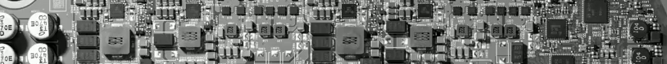

Real-Time Operating System (Day 4 Lab)
Jong-Chan Kim
Graduate School of Automotive Engineering

Slide 2
22. Schedule Table
SCHEDULETABLE SchedTab1 {
COUNTER = mycounter;
DURATION = 10;
REPEATING = TRUE;
AUTOSTART = TRUE {
START_VALUE = 5;
};
EXPIRE_POINT = ACTION {
EXPIRE_VALUE = 0;
ACTION = ACTIVATETASK { TASK = TaskH; };
ACTION = ACTIVATETASK { TASK = TaskL; };
};
EXPIRE_POINT = ACTION {
EXPIRE_VALUE = 5;
ACTION = ACTIVATETASK { TASK = TaskH; };
ACTION = SETEVENT { TASK = TaskL; EVENT = Event1; };
};
};
Cycle Time
Start Offset
Task Activation
Event Setting

Slide 3
22. Schedule Table
3개 Task 생성 및 Scheduling 실험
Timing diagram
(5, 2.5)
TaskH
Time
0
5
10
15
20
25
30
(10, 2)
TaskM
Time
0
5
10
15
20
25
30
(15, 0.5)
TaskL
Time
0
5
10
15
20
25
30

Slide 4
23. End-to-End Delay
AUTOSAR 기반 DAG (Directed Acyclic Graph) SW 구조
Sensor에서 Actuator까지 End-to-End Delay 관찰
UP or DOWN
1
2
3
ButtonISR
TimerISR

Slide 5
23. End-to-End Delay
아래 복잡한 DAG 구조를 정의하고 Delay 측정
세 입력이 모두 UP 혹은 DOWN이면 반응
2
3
UP or DOWN
1
4
7
ButtonISR
TimerISR
UP or DOWN
5
6

Slide 6
Questions

